Slide 1


GBME Probability and Statistics
Lecture 18
Lecture 18
More about tests and Intervals
CHOONG-WAN WOO | COCOAN lab | http://cocoanlab.github.io

Slide 2
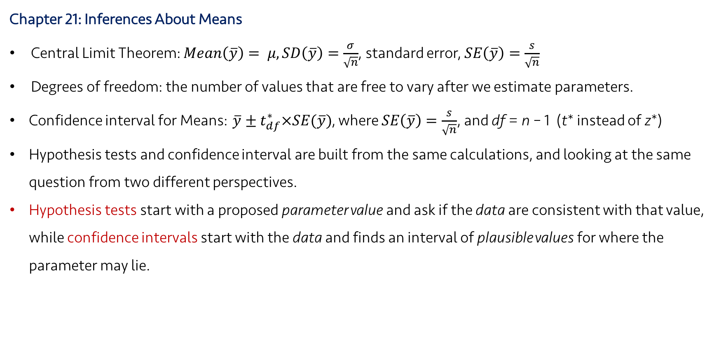
Lecture 18
Review: Key Points
Chapter 21: Inferences About Means
Central Limit Theorem: $Mean\left(\overline{y}\right)= μ, SD\left(\overline{y}\right)=\frac{σ}{\sqrt{n}}$, standard error, $SE\left(\overline{y}\right)=\frac{s}{\sqrt{n}}$
Degrees of freedom: the number of values that are free to vary after we estimate parameters.
Confidence interval for Means: $\overline{y}±t_{df}^{∗}×SE(\overline{y})$, where $SE\left(\overline{y}\right)=\frac{s}{\sqrt{n}}$, and df = n – 1 (t* instead of z*)
Hypothesis tests and confidence interval are built from the same calculations, and looking at the same question from two different perspectives.
Hypothesis tests start with a proposed parameter value and ask if the data are consistent with that value, while confidence intervals start with the data and finds an interval of plausible values for where the parameter may lie.
CHOONG-WAN WOO | COCOAN lab | http://cocoanlab.github.io

Slide 3
Lecture 18
What’s P-value again?
P-value = P(Data | H₀), not P(H₀ | Data)
The conditional probability of getting the data given that the null hypothesis is true
NOT the probability that the null hypothesis is true
NOT the conditional probability that the null hypothesis is true given the data
P-value = 0.03
does NOT mean “there is a 3% chance that the null hypothesis is true”.
does mean “given the null hypothesis, there’s a 3% chance of observing the observed statistic value.
CHOONG-WAN WOO | COCOAN lab | http://cocoanlab.github.io

Slide 4
Lecture 18
Small P-value
First, yay!
It means the result we just observed is unlikely to occur if the null hypothesis is true.
does NOT mean that the null hypothesis is “less true”.
How small the P-value should be?
depends on a lot of things, e.g., your prior belief in the null hypothesis, your trust in your data, in the experimental method, in the survey protocol, etc.
P-value serve as a measure of the strength of the evidence against the null hypothesis
should NEVER serve as a hard and fast rule for decisions.
YOU have to take the responsibility for the decision on yourself.
CHOONG-WAN WOO | COCOAN lab | http://cocoanlab.github.io

Slide 5
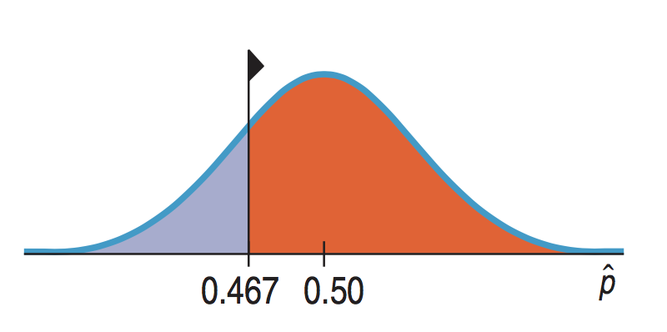
Lecture 18
High P-value
No evidence for rejecting H₀
We cannot reject the null hypothesis.
For one-sided test, if P-value is higher than 0.5, you know that your test statistic is on the “wrong” side.
High P-values mean
What we’ve observed is not surprising.
We have no reason to reject our null hypothesis.
Does NOT prove that the null hypothesis is true
Do NOT say that you “accept the null hypothesis”.
You should say that “the data have failed to provide sufficient evidence to reject the null hypothesis”.
CHOONG-WAN WOO | COCOAN lab | http://cocoanlab.github.io

Slide 6
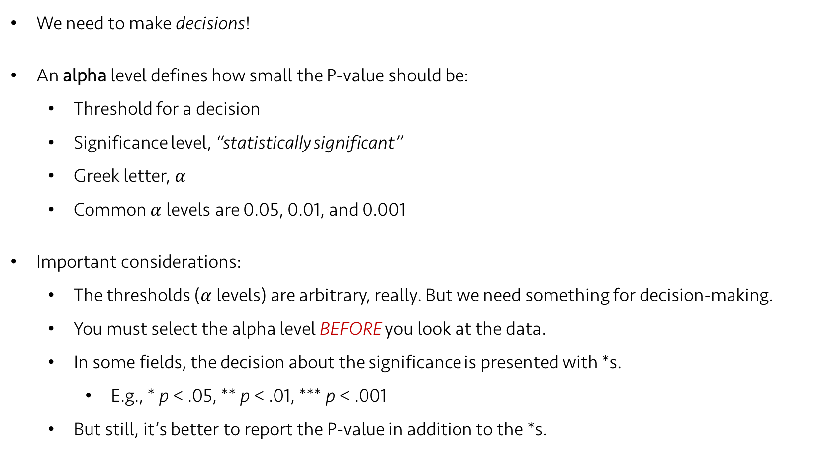
Lecture 18
Alpha levels
We need to make decisions!
An alpha level defines how small the P-value should be:
Threshold for a decision
Significance level, “statistically significant”
Greek letter, $α$
Common $α$levels are 0.05, 0.01, and 0.001
Important considerations:
The thresholds ($α$levels) are arbitrary, really. But we need something for decision-making.
You must select the alpha level BEFORE you look at the data.
In some fields, the decision about the significance is presented with *s.
E.g., * p < .05, ** p < .01, *** p < .001
But still, it’s better to report the P-value in addition to the *s.
CHOONG-WAN WOO | COCOAN lab | http://cocoanlab.github.io

Slide 7
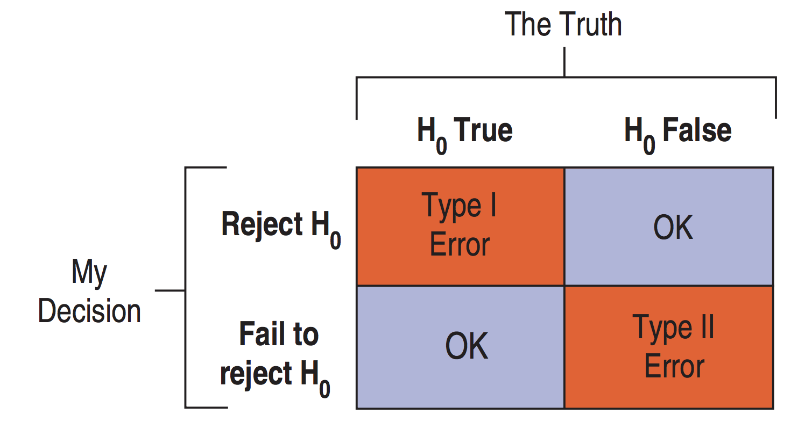
Lecture 18
Type I and II errors
We can make wrong decisions.
Two types of errors:
Type I error: The null hypothesis is true, but we mistakenly reject it. – False positive
Type II error: The null hypothesis is false, but we fail to reject it. – False negative
CHOONG-WAN WOO | COCOAN lab | http://cocoanlab.github.io

Slide 8
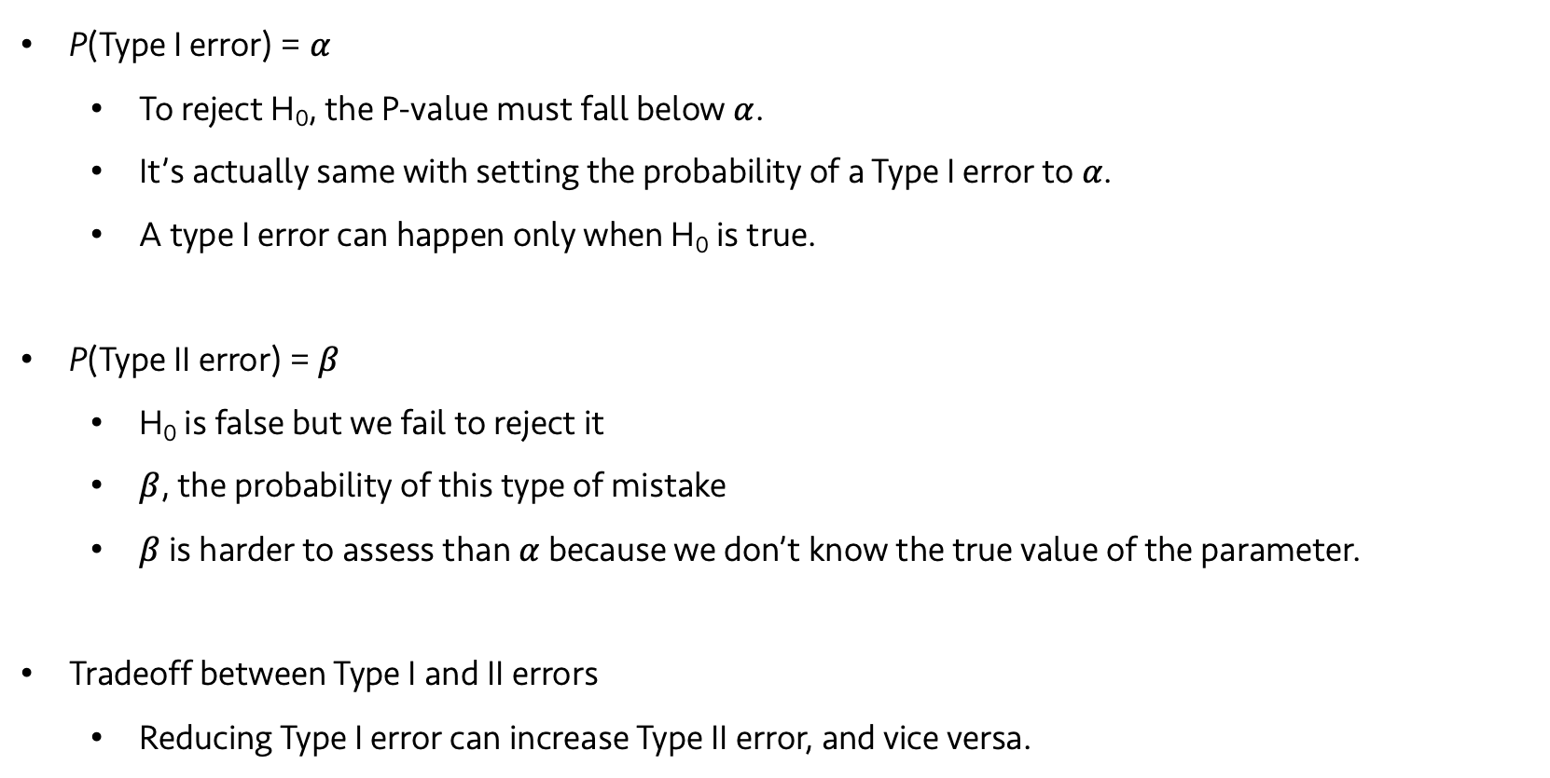
Lecture 18
More about the errors
P(Type I error) = $α$
To reject H₀, the P-value must fall below $α$.
It’s actually same with setting the probability of a Type I error to $α$.
A type I error can happen only when H₀ is true.
P(Type II error) = $β$
H₀ is false but we fail to reject it
$β$, the probability of this type of mistake
$β$ is harder to assess than $α$ because we don’t know the true value of the parameter.
Tradeoff between Type I and II errors
Reducing Type I error can increase Type II error, and vice versa.
CHOONG-WAN WOO | COCOAN lab | http://cocoanlab.github.io

Slide 9
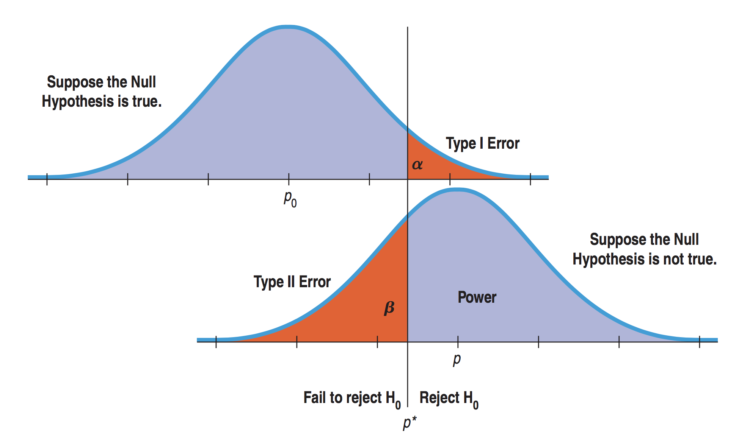
Lecture 18
Alpha and beta in a picture (1)
Tradeoffs between alpha and beta
CHOONG-WAN WOO | COCOAN lab | http://cocoanlab.github.io

Slide 10
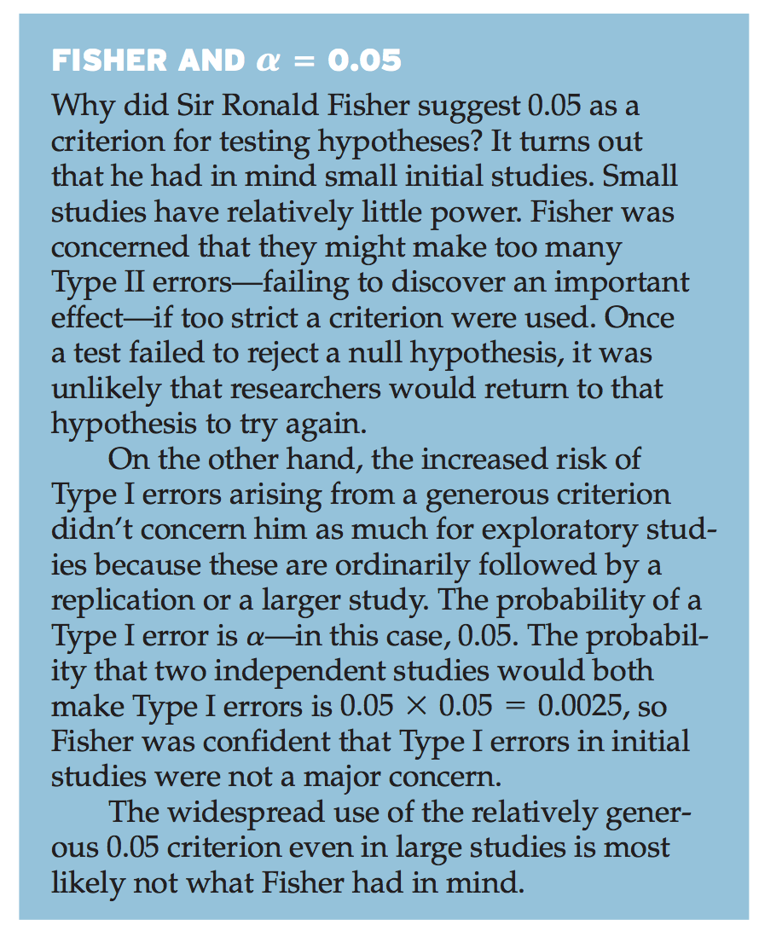
Lecture 18
Why most popular alpha = 0.05?
CHOONG-WAN WOO | COCOAN lab | http://cocoanlab.github.io

Slide 11
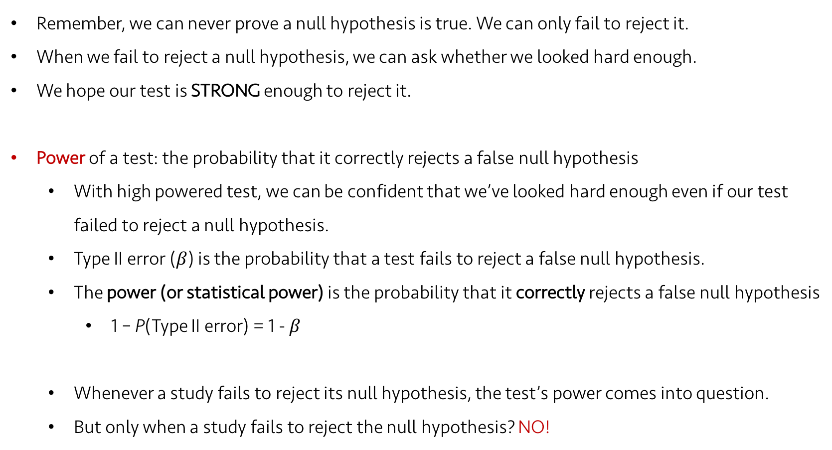
Lecture 18
Power
Remember, we can never prove a null hypothesis is true. We can only fail to reject it.
When we fail to reject a null hypothesis, we can ask whether we looked hard enough.
We hope our test is STRONG enough to reject it.
Power of a test: the probability that it correctly rejects a false null hypothesis
With high powered test, we can be confident that we’ve looked hard enough even if our test failed to reject a null hypothesis.
Type II error ($β$) is the probability that a test fails to reject a false null hypothesis.
The power (or statistical power) is the probability that it correctly rejects a false null hypothesis
1 – P(Type II error) = 1 - $β$
Whenever a study fails to reject its null hypothesis, the test’s power comes into question.
But only when a study fails to reject the null hypothesis? NO!
CHOONG-WAN WOO | COCOAN lab | http://cocoanlab.github.io

Slide 12
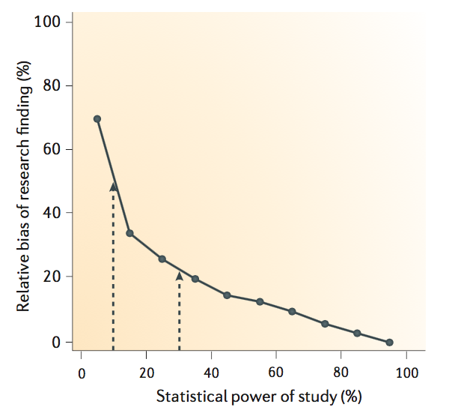
Lecture 18
Winner’s curse
Winner’s curse
h Sample size
h Effect size
i Threshold
h Power
The probability that it will correctly reject the null hypothesis when the null hypothesis is false
From Button et al., 2013, Nat Rev Neurosci, Zollner & Pritchard, 2007, Am J Hum Genet
CHOONG-WAN WOO | COCOAN lab | http://cocoanlab.github.io

Slide 13
Lecture 18
Winner’s curse
Winner’s curse
Stronger results
than real
(e.g., voodoo
correlation)
The probability that it will correctly reject the null hypothesis when the null hypothesis is false
From Button et al., 2013, Nat Rev Neurosci, Zollner & Pritchard, 2007, Am J Hum Genet
CHOONG-WAN WOO | COCOAN lab | http://cocoanlab.github.io

Slide 14
Lecture 18
Winner’s curse
Winner’s curse
Low powered studies can increase biases in literature, resulting in replication failure.
CHOONG-WAN WOO | COCOAN lab | http://cocoanlab.github.io

Slide 15
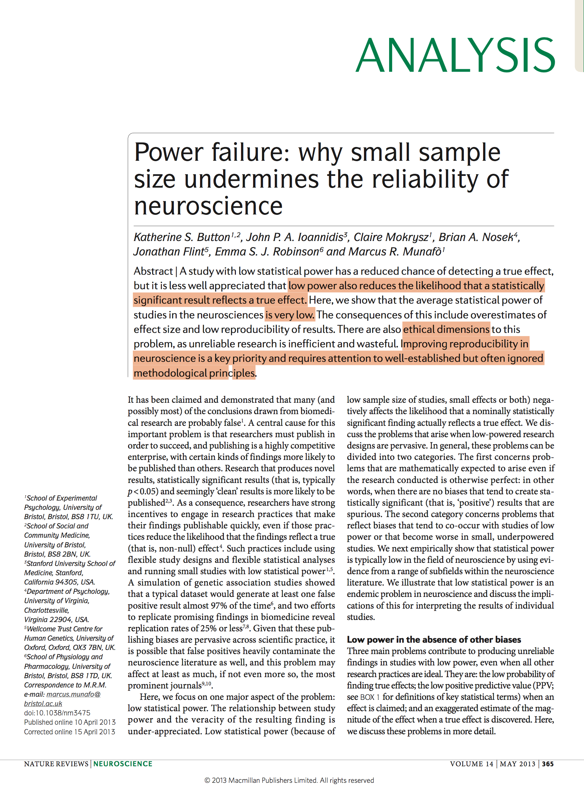
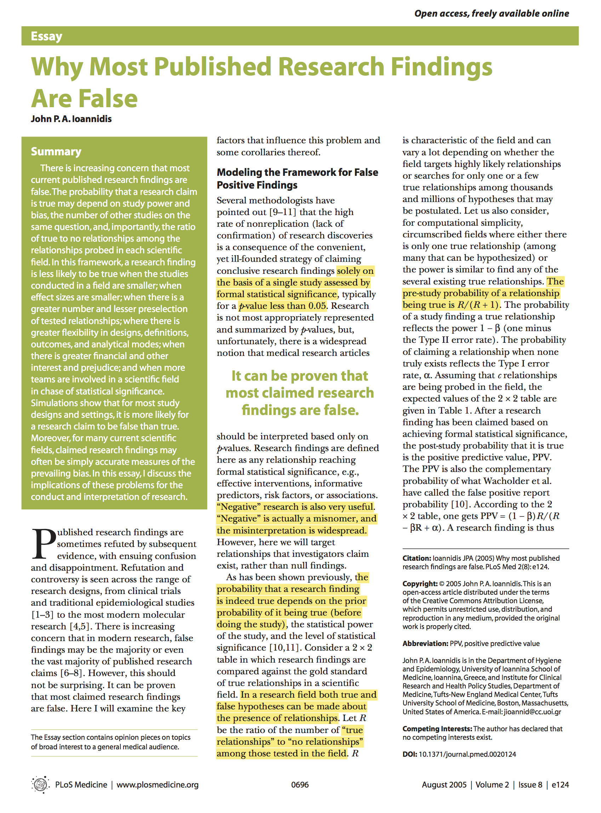
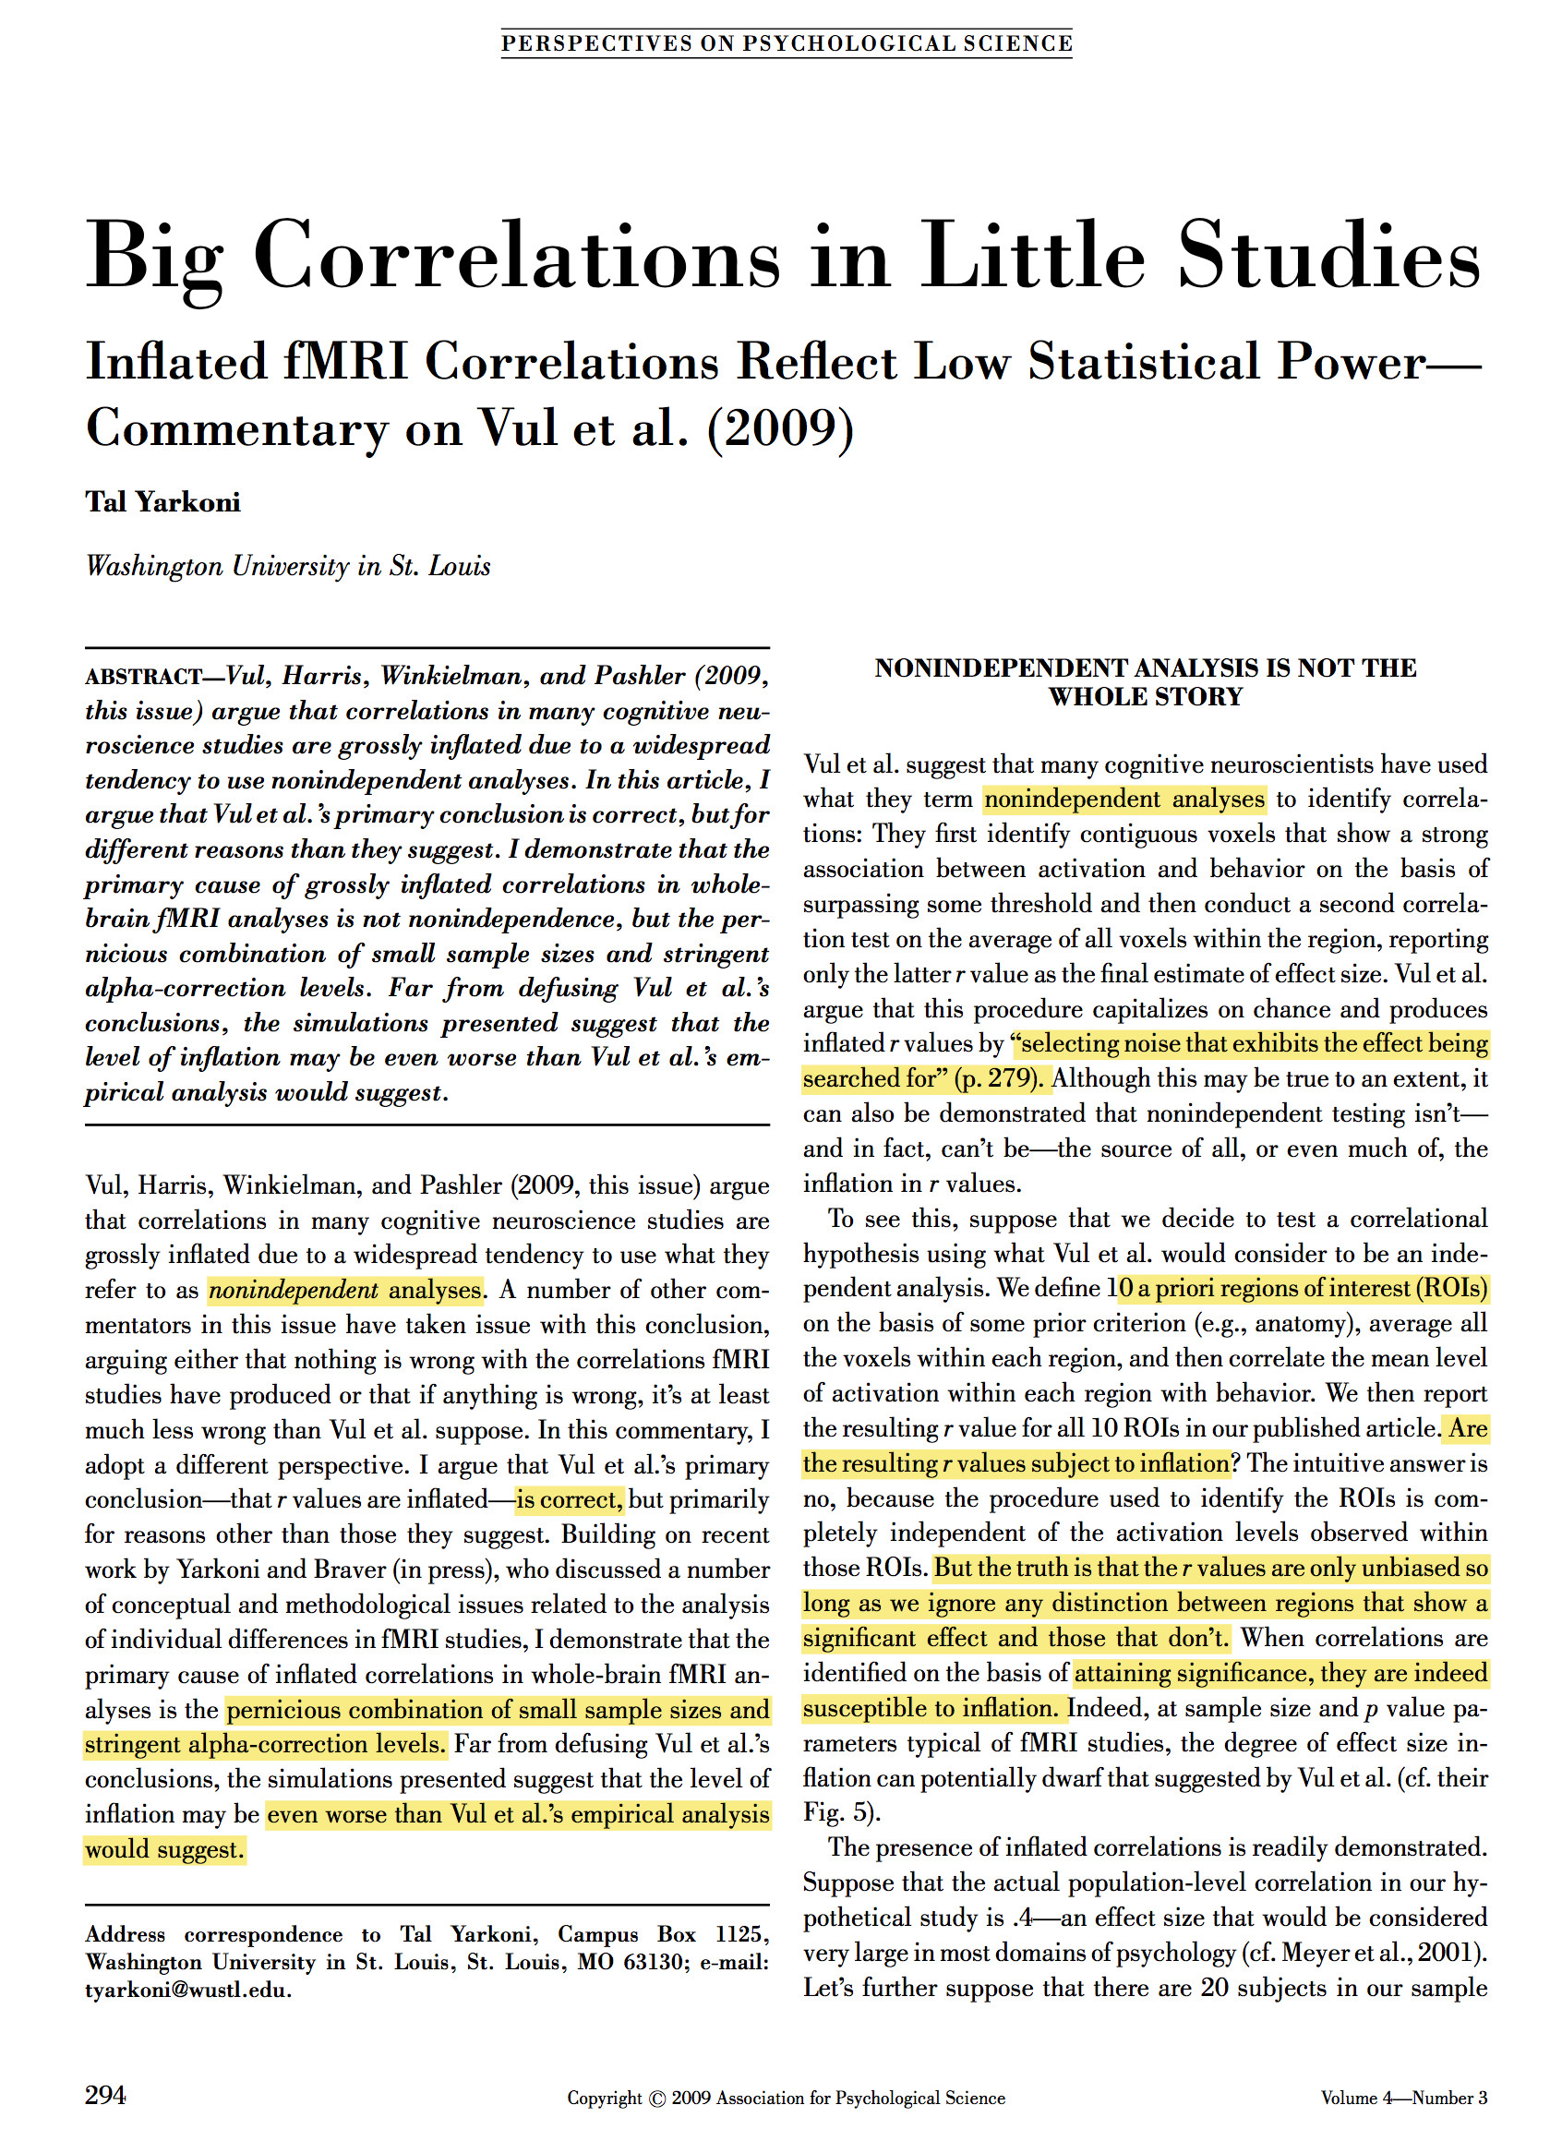
Lecture 18
Power failure: references
CHOONG-WAN WOO | COCOAN lab | http://cocoanlab.github.io

Slide 16
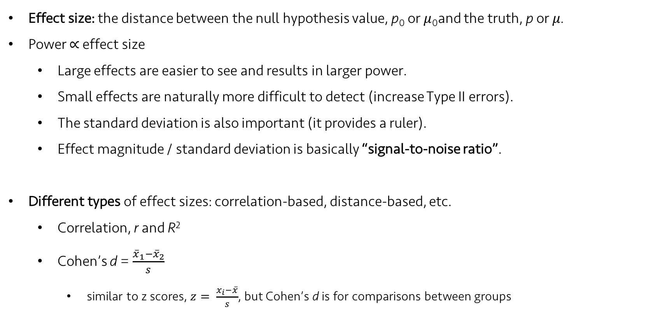
Lecture 18
Effect size
Effect size: the distance between the null hypothesis value, p₀ or $μ$₀and the truth, p or $μ$.
Power $∝$ effect size
Large effects are easier to see and results in larger power.
Small effects are naturally more difficult to detect (increase Type II errors).
The standard deviation is also important (it provides a ruler).
Effect magnitude / standard deviation is basically “signal-to-noise ratio”.
Different types of effect sizes: correlation-based, distance-based, etc.
Correlation, r and R²
Cohen’s d = $\frac{{\overline{x}}_{1}−{\overline{x}}_{2}}{s}$
similar to z scores, $z= \frac{x_{i}−\overline{x}}{s}$, but Cohen’s d is for comparisons between groups
CHOONG-WAN WOO | COCOAN lab | http://cocoanlab.github.io

Slide 17
Lecture 18
Alpha and beta in a picture (2)
Power = 1 – beta
Tradeoffs between alpha and beta
The role of effect size in power
CHOONG-WAN WOO | COCOAN lab | http://cocoanlab.github.io

Slide 18
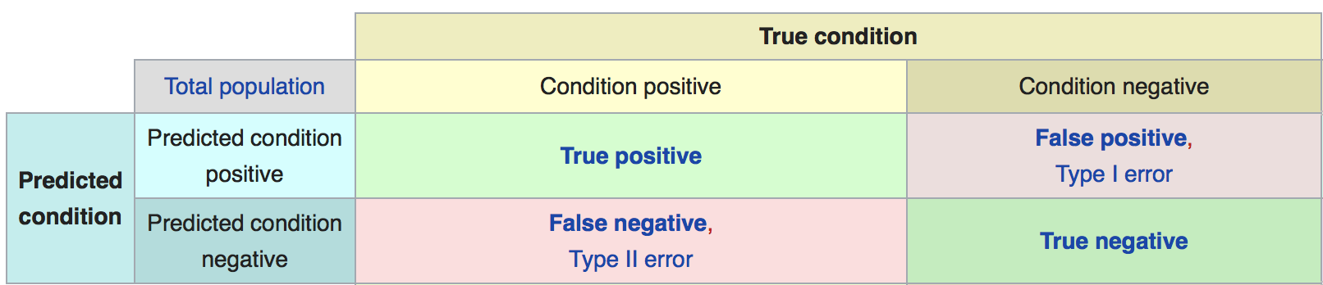

Lecture 18
Sensitivity and Specificity
https://en.wikipedia.org/wiki/Sensitivity_and_specificity
Specificity = # true negatives / (# true negatives + # false positives) = 1 - $α$
Sensitivity = # true positives / (# true positives + # false negatives) = 1 - $β$ = Power
Confusion matrix
CHOONG-WAN WOO | COCOAN lab | http://cocoanlab.github.io

Slide 19
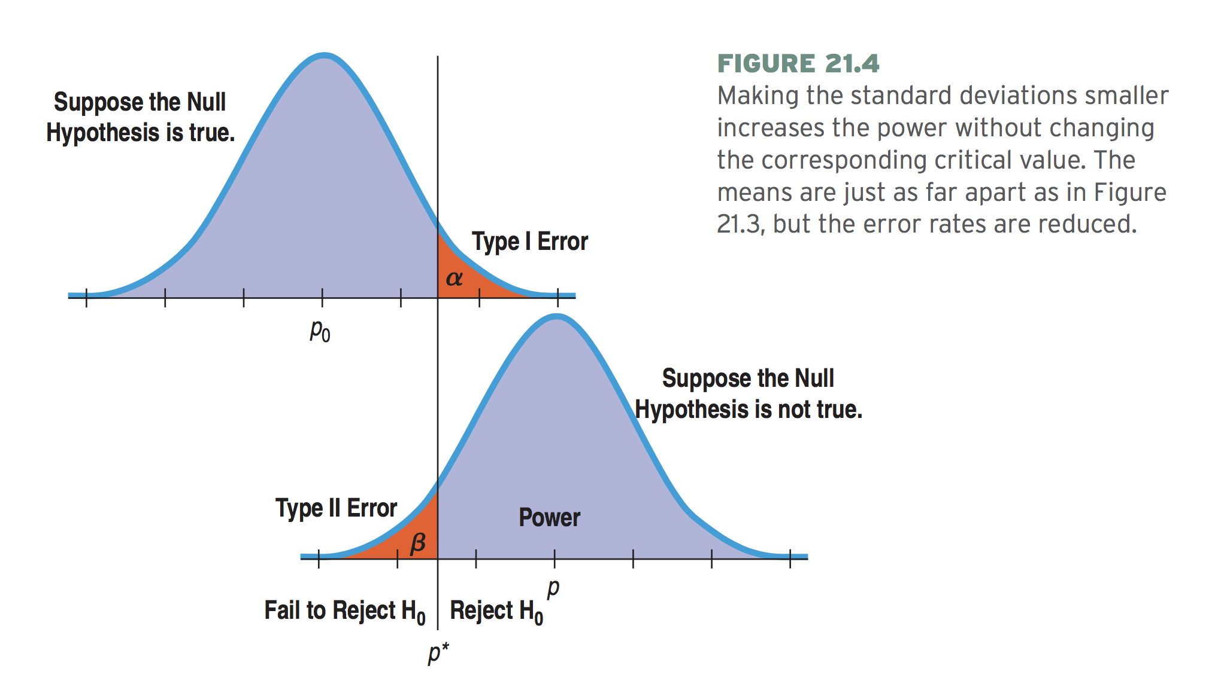
Lecture 18
Reducing both Type I and II errors
CHOONG-WAN WOO | COCOAN lab | http://cocoanlab.github.io

Slide 20
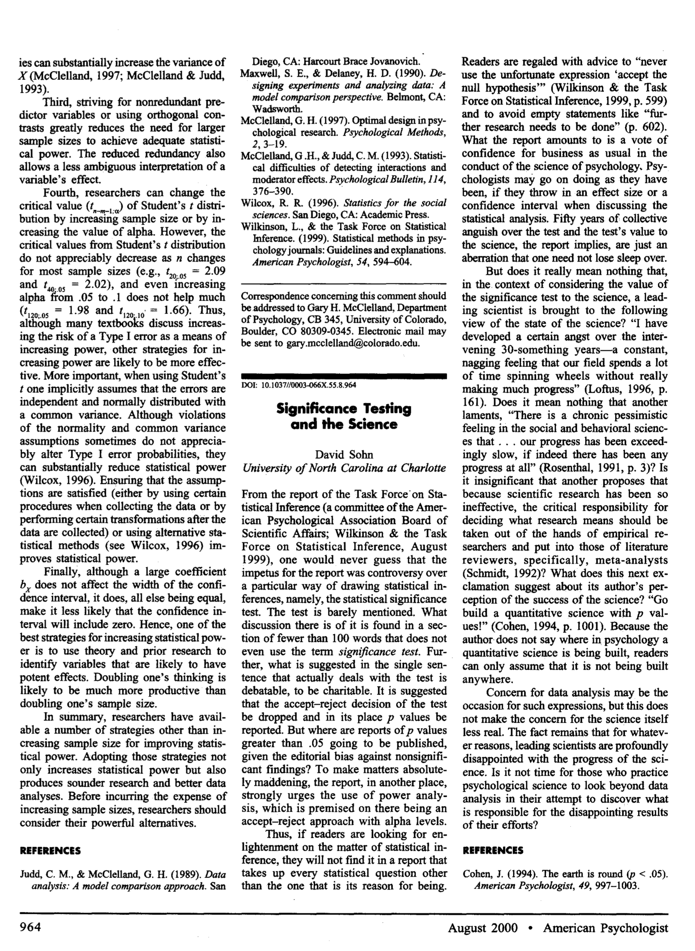
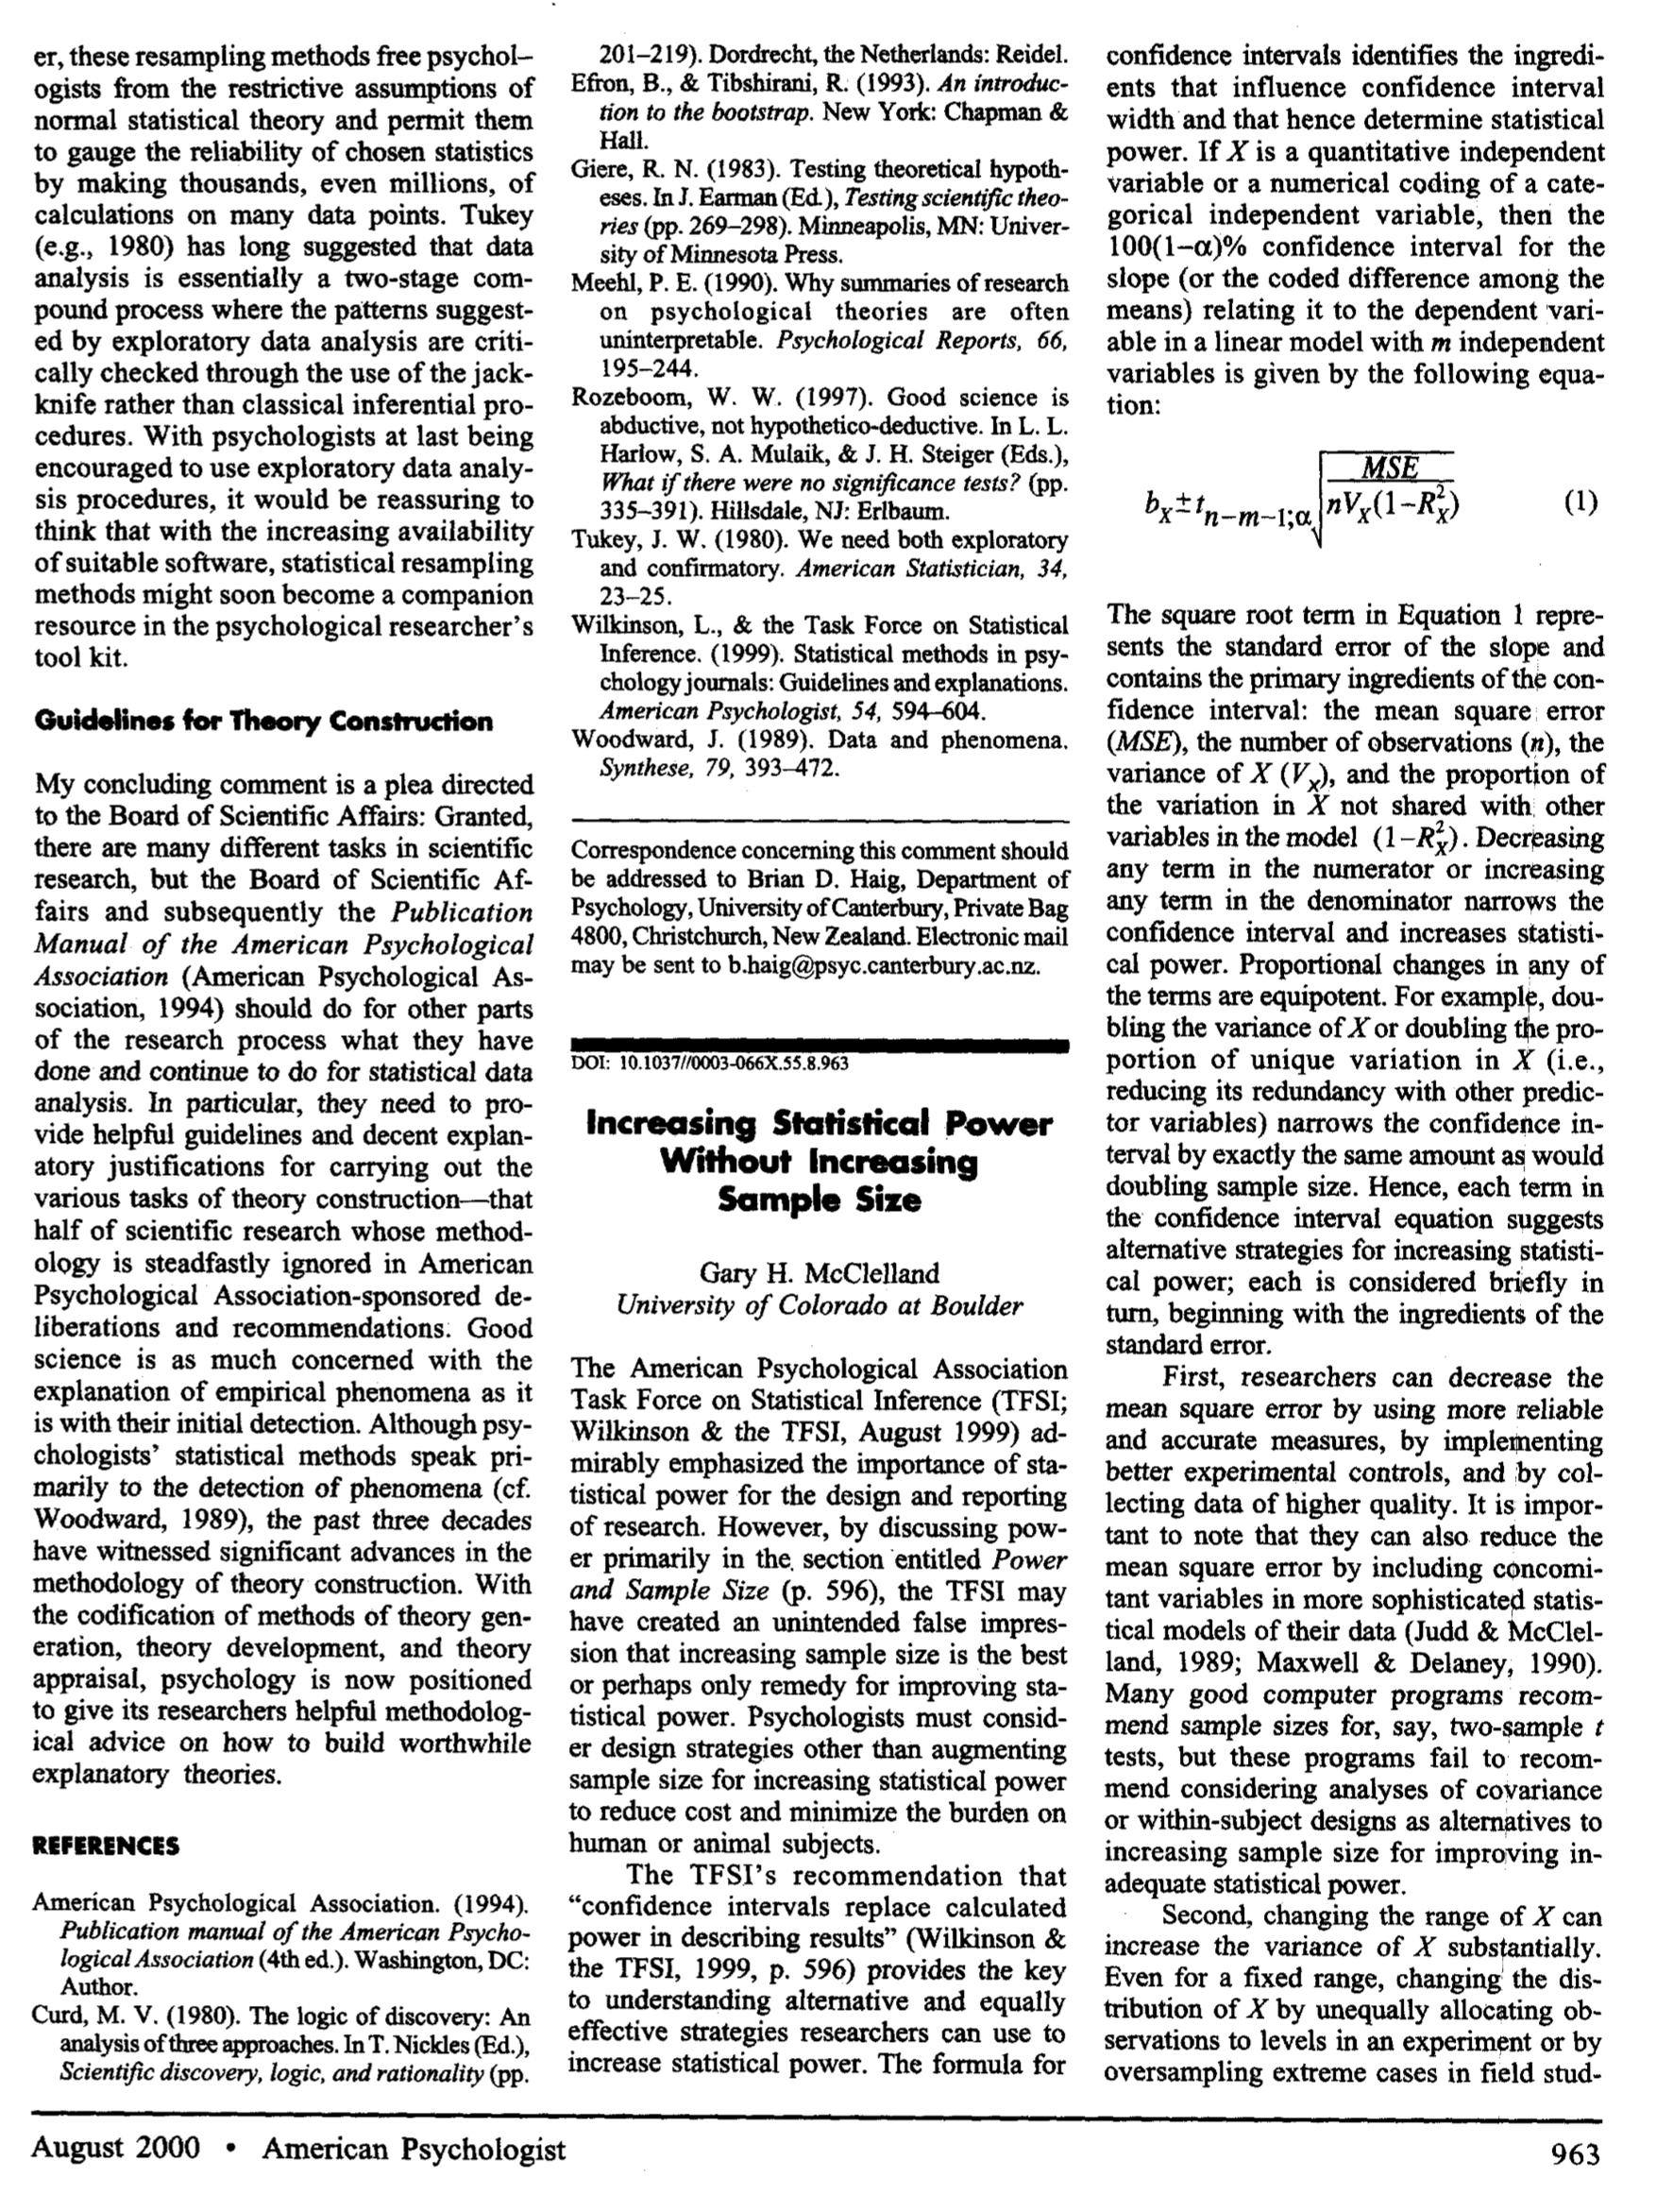
Lecture 18
Increasing Power without increasing sample size:
CHOONG-WAN WOO | COCOAN lab | http://cocoanlab.github.io

Slide 21
Lecture 18
Key Points
Chapter 22: More about Tests and Intervals
Type I error: the null hypothesis is true, but we mistakenly reject it (false positive)
Type II error: The null hypothesis is false, but we fail to reject it (false negative)
Alpha: how small the P-value should be, P(Type I error)
Beta: the probability of Type II error
Power = 1 – beta
Winner’s curse: increased bias in low powered studies
Effect size: the distance between the null hypothesis value and the truth, but similar to signal-to-noise ratio
CHOONG-WAN WOO | COCOAN lab | http://cocoanlab.github.io

